Slide 1
REAL TIME HEART RATE MONITORING SYSTEM USING WEBCAM
GUIDE : Dr. SABITHA S
SUBMITTED BY
ARYA JAYAN
TVE20MCA-2023
S3 MCA
COLLEGE OF ENGINEERING
TRIVANDRUM

Slide 2
AIM
To create a real­ time, non­contact heart rate monitoring program that utilizes a simple camera to capture facial information.
Heart rate is one of the most commonly measured physiological makers, and provides the user with important feedback on their current state of health.
In the past, it has been necessary to have direct contact to the skin in order to measure one’s heart beat.
With the advent of powerful computer vision processing libraries, such as OpenCV, and advanced signal filtering techniques, it is now possible to extract accurate heart rate measurements through facial recognition and independent component analysis (ICA).
The success of this project would provide users access to accurate heart rate monitoring information ­­if they are unable to obtain their pulse by themselves ­­and would give healthcare officials the ability to measure heart rate without needing direct access to a patient’s skin surface.

Slide 3
INTRODUCTION
In this project I am proposing a non-invasive heart rate monitoring system, to monitor subjects of different age groups using Digital Image Processing.
A simple web cam can identify the colour changes of the skin during the flow of blood as it fills the face.
From this result, it is possible to extract the subject’s heart rate.
The main field of research is image processing and computer vision.
Variations in videos that are difficult or impossible to see with the naked eye are revealed by taking a standard video of the subject as input and then performing face tracking.
After that, pyramid decomposition is applied, followed by filtering of the frames. The hidden information can be revealed from the resulting signal. We are thus able to visualize the flow of blood as it fills the face.

Slide 4
REQUIREMENTS
HARDWARE REQUIREMENTS
PROCESSOR : Intel Core 2 Duo (2.50 GHz)
MEMORY : 2048 MB
HARD DISK : 40 GB
MONITOR : EGA/VGA
CAMERA : HD Webcam
SOFTWARE REQUIREMENTS
OPERATING SYSTEM : Windows 10
LANGUAGE : Python

Slide 5
EXISTING SYSTEM
The existing system uses Finger Monitors, ECG and some other devices based on Bluetooth and PPG.
These require contact with person’s skin in order to get the heart rate measurement. This can cause discomfort for patients who are really weak and it will be very difficult to get the accurate heart rate measurement.
In hospitals, ECG or EKG is used which records a graph of voltage against time representing the electrical activity of the heart using electrodes placed on the skin. This may cause irritation as well as stress to the patients.
The finger monitors require the patient to place a clamp-like device on the finger and these may not be accurate always since it measure the amount of oxygen in the blood by passing small beams of light.

Slide 6
PROPOSED SYSTEM
This project proposes a method which is capable of estimating a person’s heart rate using a standard camera based on colour variations on the skin caused by blood flow, which in most cases, is invisible to the naked eye. This is a simple and low cost procedure with large applicability in many areas such as lie detection, medicine and surveillance.
The proposed method is based on an established framework of face detection, filtering and peak detection from the acquired signal and by adding a novel decision algorithm to make the heart rate estimation based on the past history of the signal. If there is good lighting and minimal noise due to motion, a stable heartbeat can be isolated in about 30 seconds

Slide 7
LITERATURE SURVEY

Slide 8
A NON-INVASIVE TELEMETRIC HEART RATE MONITORING SYSTEM BASED ON PHONOCARDIOGRAPHY
In this paper a reliable method of measuring the pulse rate is presented. L. TorresPereira from University of Tras-os-Montes & Alto Douto, Portugal and her team described a non-invasive and reliable bio telemetric heart rate monitoring system which causes minimal constraints to patients.
From the activity of muscles, valves or blood flux in the heart, heart sounds arise. The acoustic vibration caused by the mechanical action of the heart is detected using piezoelectric transducers. A small size intelligent probe is glued to the chest of the patient or subject.
The probe uses a sensor and have signal processing and telemetric capabilities. The advantage of telemetric phonography over the ECG is that it only requires a single probe and there are no wire connections, so that the patient need not carry a Holter.
The heart sound detection has two factors to be considered.
i) Wide variation in heart sounds morphologies and rythms.
ii) Noise from various sources may corrupt the phonocardiogram recordings
These are the conditions which imply the use of a heart sound probe self-adjustable to sound signal levels and selecting only heart sounds.

Slide 9
BLUETOOTH LOW ENERGY (BLE) BASED MOBILE ELECTROCARDIOGRAM MONITORING SYSTEM
Bin Yu, Lisheng Xu and Yongxu Li developed a wireless Electrocardiogram (ECG) monitoring system based on Bluetooth low energy methodology.
This system consists of a single-chip, Bluetooth module and a smart phone. According to this paper, the monitoring system acquires the ECG signals through a 2-lead ECG sensor and transmits the ECG data through the Bluetooth wireless link.
The data is then processed and the ECG wave form is displayed in the smart phone. This system eliminates the hard wiring imposed on patients.
It also reduces the power consumption of the long term monitoring system.

Slide 10
CONTACT-FREE MEASUREMENT OF CARDIAC PULSE BASED ON THE ANALYSIS OF THERMAL IMAGERY
Human cardiac pulse can be measured from at a distance using thermal imagery.
This system uses a highly sensitive thermal imaging system to get the thermal signals which are emitted from superficial vessels.
The temperature on the vessel is modulated by the pulsative blood flow.
The frequency of the pulse is computed by extracting a line based region, along the vessel.
Along the line of interest FFT (Fast Fourier Transform) is applied to individual points and the thermal propagation effect is capitalized. The FFT outcome undergoes adaptive estimation function and pulse is quantified.
Marc Garbey ; Nanfei Sun ; Arcangelo Merla and Ioannis Pavlidis have carried out experiments on a dataset consisting of 34 subjects.
They compared the computed pulse from the thermal signal analysis method to concomitant ground-truth measurements obtained through a standard contact sensor (piezo-electric transducer).
It was the first time that cardiac pulse has been measured several feet away from a subject with passive means. Depending on the clarity of the vessel’s thermal imprint, the performance of the new method ranges from 88.52% to 90.33%

Slide 11
REMOTE PLETHYSMOGRAPHIC IMAGING USING AMBIENT LIGHT
Plethysmography means detecting the heart pulse through the body.
Photo Plethysmography(PPG) uses light reflectance or transmission and was introduced in the 1930’s.
Using a simple digital camera and ambient light, Plethysmographic signals could be measured remotely.
Green, red and blue channels are contained in plethysmographic information. Among those green channel is the strongest plethysmographic signal, peak absorption by haemoglobin. Blood absorbs more light than surrounding tissues, therefore transmission or reflectance is affected by the variations in the blood volume.
This principle is used in PPG. Photo – plethysmography can be used in medical purposes such as vascular skin lesions characterization (for eg., port wine stains) and remote sensing of heart and respiration rates.
This is the least expensive method and is simple to use.

Slide 12
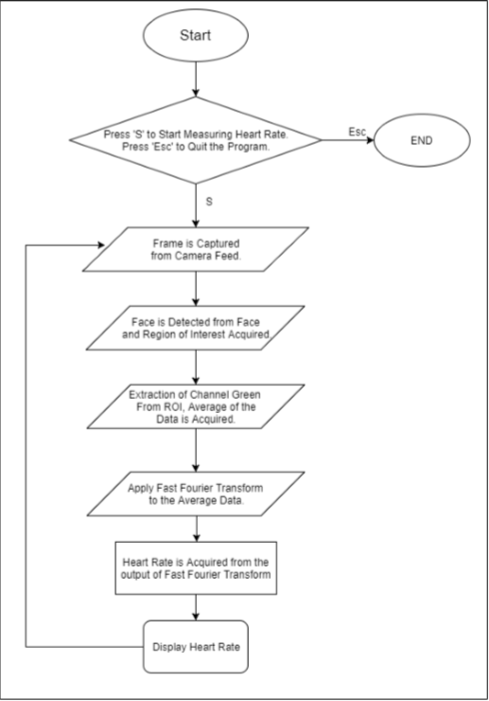
FLOWCHART

Slide 13
The steps performed during heart rate measurement,
Frames from the webcam is captured.
Face detection algorithm is used to track face.
Region of Interest is cropped from the frame for faster processing.
Average pixel value of Green from ROI is calculated and plotted.
Frequency domain filtering is used to smooth the signal.
Peak Detection and Recurring Point of Interest is analysed.
Hence displays the Heart Rate of the Person.

Slide 14
DATA FLOW DIAGRAM
The DFD takes an input-process-output view of a system i.e. data objects flow into the software, are transformed by processed elements, and resultant data objects flow out of the software.
Data objects represented by labelled arrows and transformation are represented by circles also called as bubbles. DFD is presented in a hierarchical fashion i.e. the first data model represents the system as a whole. Subsequent DFD refine the context diagram (level 0 DFD), providing increasing details with each subsequent level.
The DFD enables the software engineer to develop models of the information domain & functional domain at the same time.
As the DFD is refined into greater levels of details, the analyst performs an implicit functional decomposition of the system. At the same time, the DFD refinement results in a corresponding refinement of the data as it moves through the process that embody the applications

Slide 15
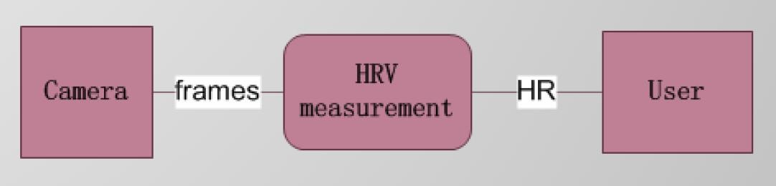
LEVEL 0

Slide 16
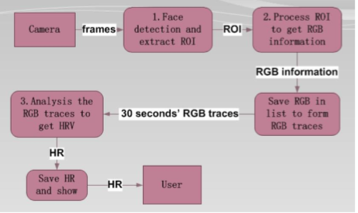
LEVEL 1

Slide 17
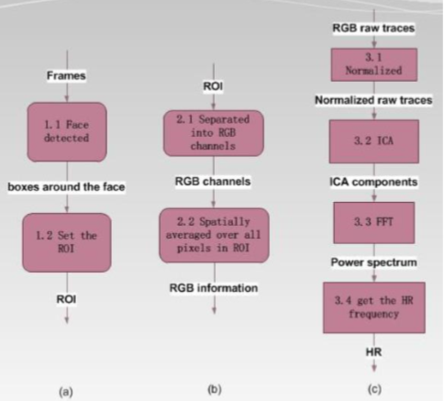
LEVEL 2

Slide 18
METHODOLOGY
The experiment was taken place in two phases:
Firstly the real time HR extraction was conducted along with stress system as a reference. All the facial image frames will be saved and used for offline testing.
Secondly the HR is extracted again in offline using the image sequences saved.

Slide 19
Reading Image Frames
The fundamental part of a video or any image source is an image frame, which indicates the start and end point of a video or it represents a silent part of that video.
The real time HR monitoring system extracts a number of image frames one by one over a fixed period of time defined by the user.
It is also important to observe that the resolution of the video should remain same during each image frame extraction for further calculations.
Therefore, we have used a novel key frame video extraction algorithm to maintain same resolution that can read image frames automatically one by one.

Slide 20
Face Tracking
The input of the proposed non-contact HR monitoring algorithm is facial image and hence it is very much important to track facial part of the user.
The real time method would require a powerful face tracking method to perform higher face detection rate.
After extracting an image frame in real time, the automatic face detection function is applied. Later the function is modified to fulfil our own purposes.

Slide 21
Region of Interest Selection
R, G and B colour values of each pixel of the facial image frames are the most essential part for this experiment.
Therefore, we have searched a perfect Region of Interest (ROI) over the detected face. The detected face contains some unwanted part which needs to eliminate.
To identify the coordinates of the face location in the first frame a boosted cascade classifier is used for the x and y-coordinates along with the height and width that defines a box around the face, depending on the method.
Therefore the center is selected as 60% width and 80% height of the box as the region of interest which is free from unwanted parts.
Only the ROI is then separated from the entire facial image and this ROI is used for further calculations

Slide 22
RGB Signals Extraction
R, G, B colour values are the fundamental elements of R, G and B signals (together they are called RGB signals) which are extracted from the facial cropped ROI image.
Each pixel of the image has 3 x 1 matrix of colour values which consists of Red (R), Green (G) and Blue (B) colour of the image.
Then the three desired signals Red, Green and Blue signals are produced in two phases.
In the first phase the average R, G and B colour values are calculated for each image frame.
In the second phase the red, green and blue signals are calculated from the summation of all the averaged R, G and B colour values.

Slide 23
Signal Detrending
Detrending is a significant signal processing concept, that is used to remove unwanted trend from the series.
This is useful when a feature is distorted from the relationships of interest.
In this case, when environmental parameters such as temperature or external noise changes, the collected RGB signals will be drifting and noising.
Therefore the signals need to detrend.
The RGB signal has been detrended using the method used in based on smoothness priors approach with the smoothing parameter λ =10 and cutoff frequency = 0.059 Hz.

Slide 24
Filtering
Before applying PCA, ICA and FFT the Red, Green and Blue signals formed from all red, green and blue image frames are filtered by Hamming window (128 point, 0.6-2 Hz, for normal HR 36-120) for heart rate.

Slide 25
Normalization
The signal needs to be normalized and the normalization has been performed according to the method.
The below equation shows the normalization formula.
𝑋𝑖 (𝑡) = 𝑌𝑖 (𝑡)− µ𝑖 (𝑡) 𝛿𝑖 (1) For each i = R, G and B signals ;
where µ𝑖 is the mean and 𝛿𝑖 is the standard deviation of 𝑌𝑖 .

Slide 26
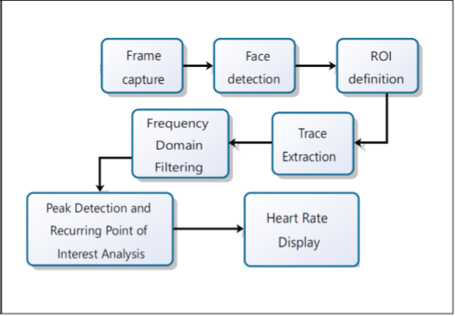

Slide 27
RESULTS
Face Tracking and ROI detection
When a Face appears in the camera feed, the program tracks the face with outline of Square, and an approx. portion of the square (Region of Interest) is pre-set in the program.
Hence face tracking and detection of the forehead is working fine.
When the start button is pressed, the users face is detected to lock the position and the user needs to stay still until the Beats per Minute(BPM) is calculated, if the face moves then there will be variations in the BPM.

Slide 28
Heart Rate Estimation
When the start button is pressed, the program locks the Face and then starts reading the data from the Region of Interest (ROI) and extracts the value of the Green Signal.
The average of the Green signal is calculated and then it is plotted into a graph.
The Fast Fourier Transform of the Plotted green signal is acquired. The high amplitude signal in FFT is taken as the Beats per Minute of the Person.

Slide 29
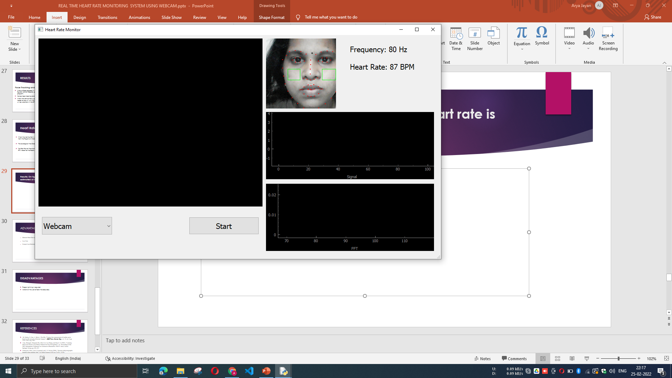
Results: On figure 7.1 the person’s heart rate is estimated at 87 BPM
Fig : Heart Rate estimated

Slide 30
Graphical Representation of Signals
The representation of the Data acquired from the Region of Interest.
The Face of the Person is shown on the top left side of the plot, there are two graphs:
the First Graph(Fig A) represents the Average of the Green signal from the Region of interest with respect to time
the Second Graph(Fig B) represents the Fast Fourier Transform of the Above Signal. The Highest amplitude signal value of FFT is used as the Beats Per Minute of the Person

Slide 31
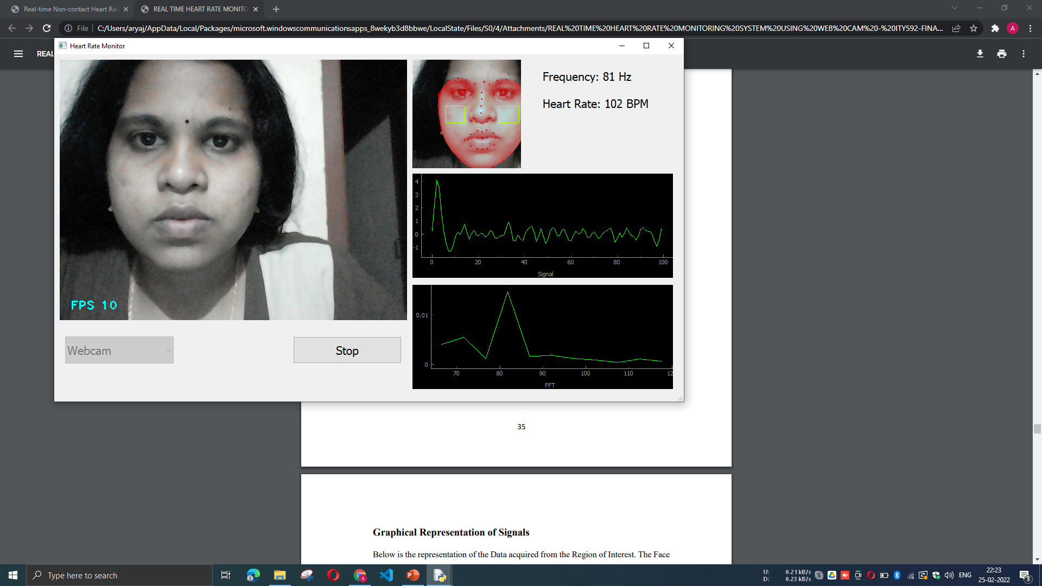
Fig A

Slide 32
Fig B

Slide 33
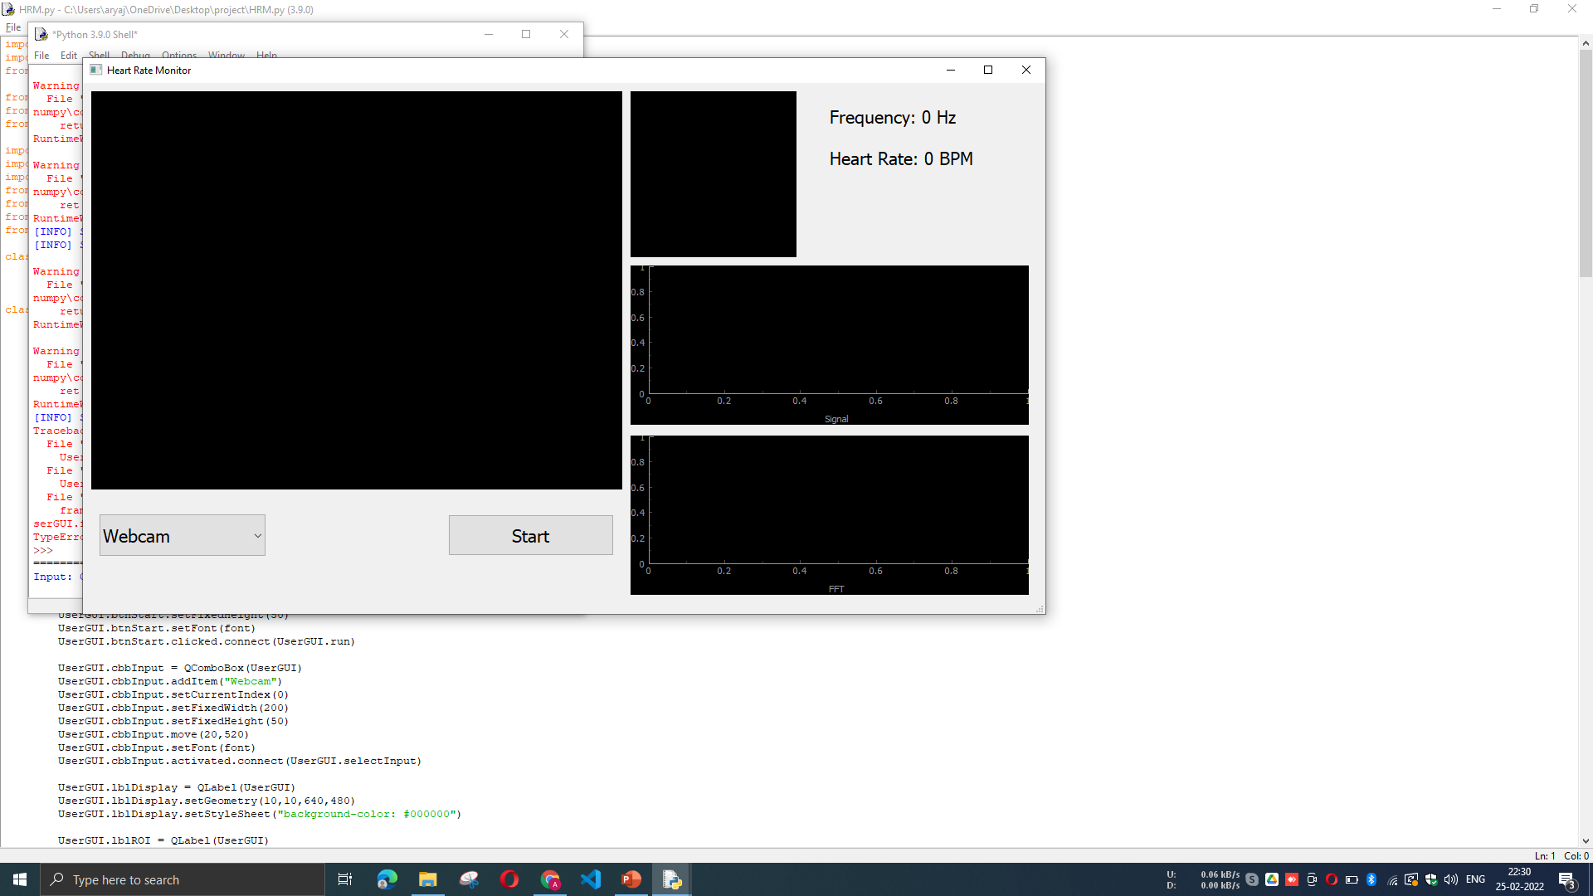
SAMPLE OUTPUT
Real Time Heart Rate Monitor Simple User Interface (Start button and camera selection)

Slide 34
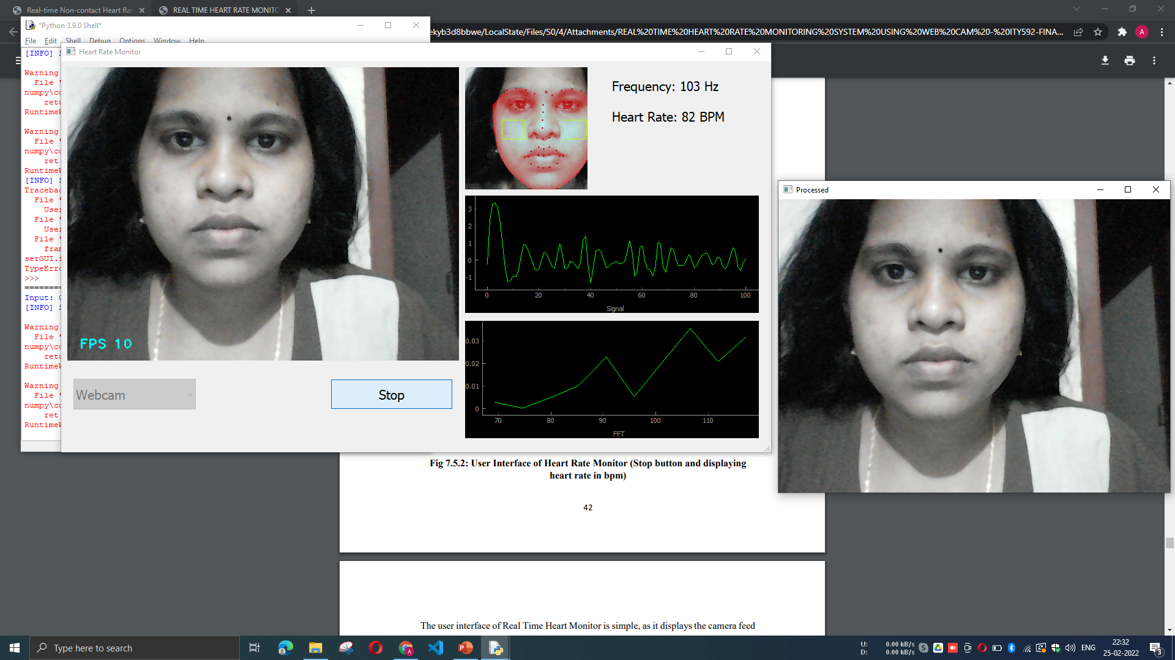
USER INTERFACE
User Interface of Heart Rate Monitor (Stop button and displaying heart rate in bpm)

Slide 35
ADVANTAGES
Measure Heart Rate at Any Time without any difficulties.
Low Cost
Contact Less Monitoring

Slide 36
DISADVANTAGES
Proper lightning is required
Motion of the user affects the accuracy

Slide 37
CONCLUSION
A real time non-contact based HR extraction method is described in this paper using facial video which is :
easy to implement,
low cost and comfortable for real time applications.
Here, the main idea is to extract HR from the colour variation in the facial skin due to cardiac pulse and the implementation has been done using a simple webcam in indoor environment with constant ambient light

Slide 38
FUTURE SCOPE
Improving the face detection location accuracy.
Eye detection method could possibly increase the position accuracy and compensate for small rotations in the face.
An alternative is using the feature tracker, which can easily correct for rotations as well as increasing the position accuracy.
The application need to test in different lighting condition to reveal the relationship between the illuminations and the performance of our technique.
Then the following research can focus on improving the robustness of our technique in different illuminations.
For more usability for the users an application for portable devices can be created, because todays portable camera devices have more color accuracy than the webcam which is useful for much accurate reading.
In the future, we can overcome the limitations, such as Less accuracy of heart beat due to movement, Skin tone of the person affect the reading and need of direct Lighting due to noise from artificial light, to make the application useful in real time scenarios.

Slide 39
REFERENCES
M.Garbey, N. Sun, A. Merla, I. Pavilidis, “Contact-free measurement of cardiac pulse based on the analysis of thermal imagery”, IEEE Trans. Biomed. Eng., vol. 54, no. 8, pp. 1418-1426,Aug. 2007.
Liao, Shengcai, Xiangxin Zhu, Zhen Lei, Lun Zhang, and Stan Z. Li (2007). “Learning Multi-scale Block Local Binary Patterns for Face Recognition”. In: Proceedings of the 2007 International Conference on Advances in Biometrics. ICB’07. Seoul, Korea: Springer-Verlag, pp. 828–837.
Verkruysse, Wim, Lars O. Svaasand, and J. S. Nelson (2008). “Remote plethysmographic imaging using ambient light”. In: Optics Express 16.26, pp. 21434– 21445.
Viola, Paul and Michael J. Jones (2004). “Robust Real-Time Face Detection”. In: Int. J. Comput. Vision 57.2, pp. 137–154.

Slide 40
THANK YOU!

